Slide 1
Information and Network Security
Classical Encryption
Baskoro Adi Pratomo
Informatics Department
Institut Teknologi Sepuluh Nopember
Surabaya, Indonesia
2021

Slide 2
Discussion
Discuss the previous assignment

Slide 3
What is cryptography
The art of writing or solving codes (Concise Oxford English Dictionary)
The study of mathematical techniques for securing digital information, systems, and distributed computations against adversarial attacks. (Introduction to Modern Cryptography)

Slide 4
What is encryption
Encryption:
The process of converting, or scrambling, plaintext to ciphertext
Plaintext:
The original message
Ciphertext:
The coded message
Decryption:
The process of converting ciphertext to plaintext
What are the differences between cryptography and encryption?

Slide 5

Why do we need encryption?
Which aspect(s) of security objectives (the CIA) is (are) protected by utilising encryption?
Confidentiality
Integrity
Availability
None of them

Slide 6





Symmetrical Encryption (aka Private-Key Encryption)
The mathematical notation:
C = E(M, K)
M = D(C, K) = D(E(M, K), K)

Slide 7

Should an encryption method be secret?
Explain your answer briefly

Slide 8
Kerchkhoffs’ Principle (Security by obscurity)
The cipher method must NOT be required to be secret, and it must be able to fall into the hands of the enemy without inconvenience

Slide 9
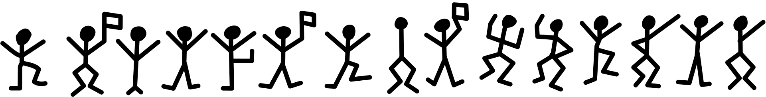
Classical Ciphers
Image taken from https://en.wikipedia.org/wiki/The_Adventure_of_the_Dancing_Men#/media/File:Dancing_men.svg

Slide 10
Caesar’s Cipher
One of the oldest recorded cipher
Originally, it works by shifting the letters of alphabet 3 places forward
Example:
BEGINTHEATTACKNOW
EHJLQWKHDWWDFNQRZ
The encryption method is FIXED!

Slide 11

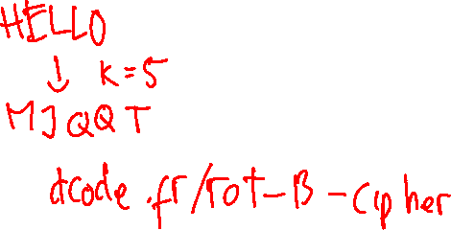
Shift Cipher (Caesar Cipher 2.0)
Formal definition:
${Enc}_{k} \left(m_{1}… m_{l}\right)=c_{1} … c_{l},$ $where c_{i}=\left[\left(m_{i}+k\right) mod 26\right]$
${Dec}_{k} \left(c_{1}… c_{l}\right)=m_{1} … m_{l},$ $where m_{i}=\left[\left(c_{i}−k\right) mod 26\right]$
If the ciphertext is as follows:
OZNOTQZNKXKLUXKOGS
What’s the original message?

Slide 12
Attacking Caesar’s Cipher
Possible attacks:
Brute-force attacks/exhaustive-search
Sufficient key-space principle
Any secure encryption scheme must have a key space that is sufficiently large to make an exhaustive-search attack infeasible
So, how big a key space must be? And is the principle sufficient?

Slide 13
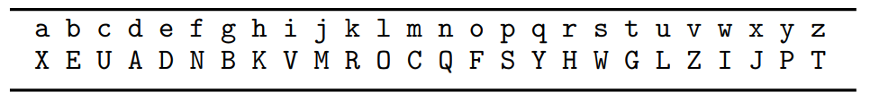

Monoalphabetic Cipher
Replacing a character to another fixed character
Mapping example:
Example:
TELLHIMABOUTME -> GDOOKVCXEFLGCD
The size of the key space: 26! ≈ $2^{88}$
Can we brute force this cipher?
Image taken from Introduction to Modern Cryptography, 3rd Edition

Slide 14
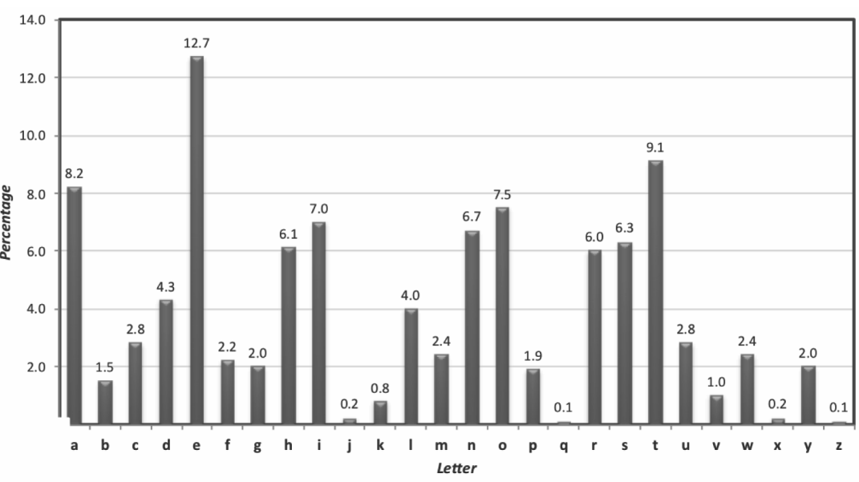
Attacking Monoalphabetic Cipher
Two facts about the cipher:
For any key, the mapping is FIXED
The frequency distribution of individual letters in English text is known
Image taken from Introduction to Modern Cryptography, 3rd Edition

Slide 15
Attacking Monoalphabetic Cipher (2)
Calculate the frequency distribution of characters in the ciphertext
Compare the frequencies to the known letter frequencies of a language
Guess the mapping based on the frequency similarity

Slide 16
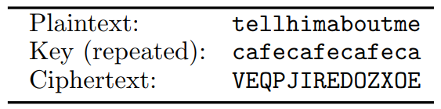
Vigenère Cipher (Polyalphabetic)
The key is now a string of letters, e.g., café
It was considered to be ‘unbreakable’ since it had been invented in the 16th century
Not until the few hundreds years later
Image taken from Introduction to Modern Cryptography, 3rd Edition

Slide 17
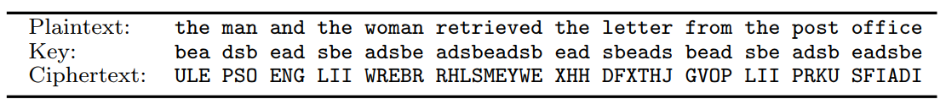
Attacking Vigenère Cipher
It is relatively easy if the key length is short
A shorter key means the key is repeated more often
It means a bigger chance for two identical parts of the plaintext to be converted to the same ciphertext
Image taken from Introduction to Modern Cryptography, 3rd Edition

Slide 18
Modern Cryptography

Slide 19
Principles If you don’t understand what you want to achieve, how can you possibly know when (or if) you have achieved it?
Cryptography is now more of a science than an art
We need a rigorous proof that the method is secure
To be able to proof something, we need formal definitions
The method needs to rely on assumptions so that we know its limitations

Slide 20


Why do we need to mention definitions? (or not?)
What are these?

Slide 21

Formal Definition (What is the definition of secure encryption?)
It should be impossible for an attacker to recover the key
It should be impossible for an attack to recover the plaintext from the ciphertext
It should be impossible for an attacker to recover any character of the plaintext from the ciphertext
Regardless of any information an attacker already has, a ciphertext should leak no additional information about the underlying plaintext

Slide 22
Threat model
Ciphertext-only attack
Known-plaintext attack
Chosen-plaintext attack
Chosen-ciphertext attack

Slide 23
Why do we need precise assumptions? (Assumptions are statements that are not proven but are conjectured to be true)
In short:
Most modern cryptographic constructions cannot be proven secure unconditionally
The long answer. We need to:
Validate the assumptions
Compare the assumptions
Understand the necessary assumptions
What if we assume the encryption method is secure. Can we do that?
A. Yes B. No

Slide 24
Provable vs Real-world Security
Key take-away:
A proof of security is always relative to the definitions and the assumptions
If the security guarantee does not match what is needed, then the proof may be irrelevant
If the threat model does not capture the adversary’s true ability, then the proof may
If the assumptions relied upon is false, then the proof is meaningless
Securely provable method does not imply the security of the method in real-world

Slide 25

Perfect Secrecy
Definition in human language:
Observing the ciphertext should have no effect on the adversary’s knowledge about the actual message that was sent
Definition in inhuman language:
$P\left(M=m | C=c\right)=P\left(M=m\right)$ $for which P\left(C=c\right)>0$

Slide 26
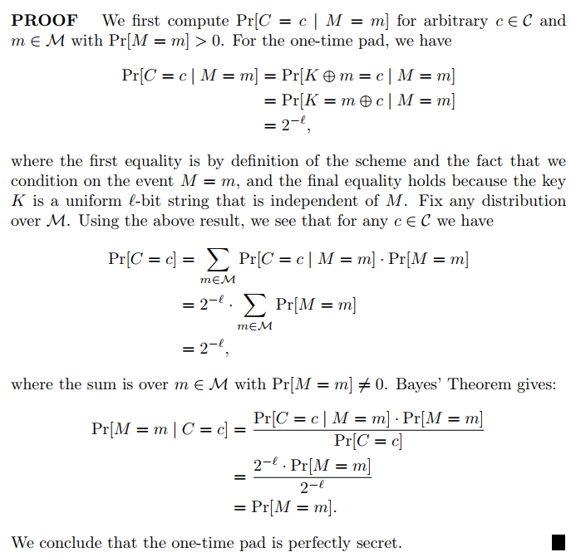

One Time Pad
Formal definition:
$c= {Enc}_{k} \left(m,k\right)=m⊕k$ $where the length l of m is equal to the length of k$
Image taken from Introduction to Modern Cryptography, 3rd Edition

Slide 27
Why don’t we use it
The key is as long as the message
It is only secure if used once

Slide 28
‘Homework’
Find information about the Galois Field
Summarise your finding in a simple sentence

